Slide 1
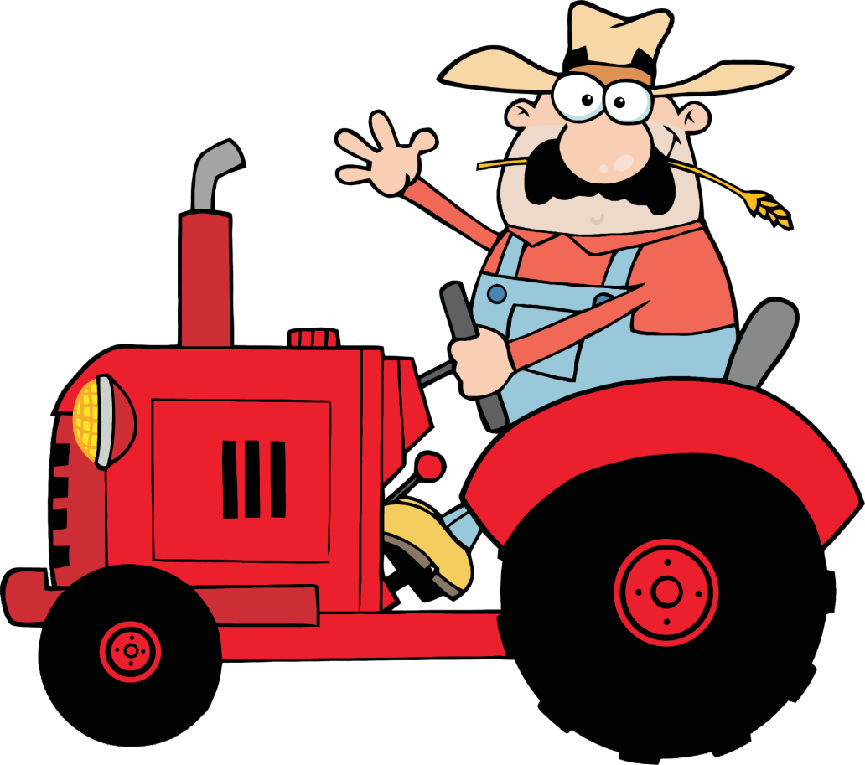
Non-Verbal
Communication
* 37 Slides
* 7 Video Clips
* 22 Word Wall Posters
* Jeopardy Review Game
Powerpoint

Slide 2
Non-Verbal Communication
any form of communication that doesn’t include words

Slide 3
Non-Verbal Communication Includes: ~ Sounds ~ Body language ~ Environmental factors
http://youtu.be/uqszKFsaBpo?t=5s

Slide 4
Characteristics of Non-Verbal Communication

Slide 5
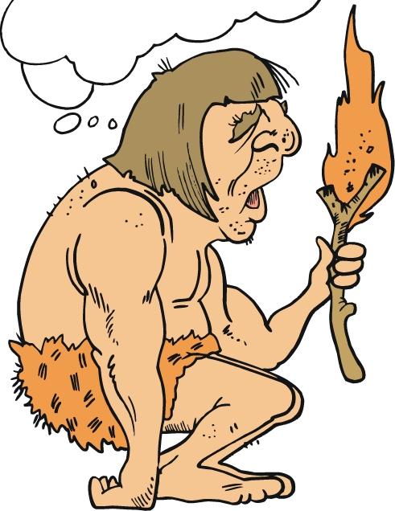
Characteristics of Non-Verbal Communication #1: Subconscious
we are often unaware of the non-verbal messages we are sending

Slide 6
Characteristics of Non-Verbal Communication #2: Contextual
non-verbal communication depends on the situations where they occur

Slide 7
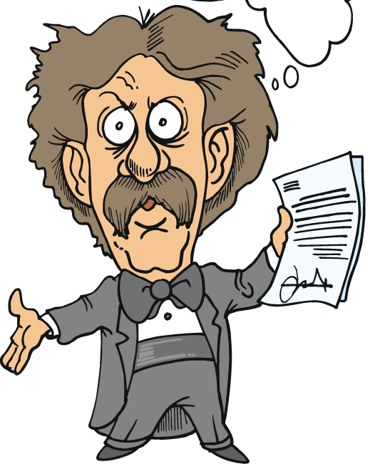
Characteristics of Non-Verbal Communication #3: Ambiguous
non-verbal messages
are open to interpretation

Slide 8
Characteristics of Non-Verbal Communication #4: Cultural
non-verbal messages can differ depending on the region

Slide 9
Characteristics of Non-Verbal Communication: 10 Surprising Ways to Offend People in Other Countries
https://www.youtube.com/watch?v=UTE0G9amZNk

Slide 10
Functions of Non-Verbal Communication

Slide 11
Functions of Communication #1: Repeat
when a nonverbal message conveys the same idea as the verbal message;
*the message is still apparent without the verbal

Slide 12
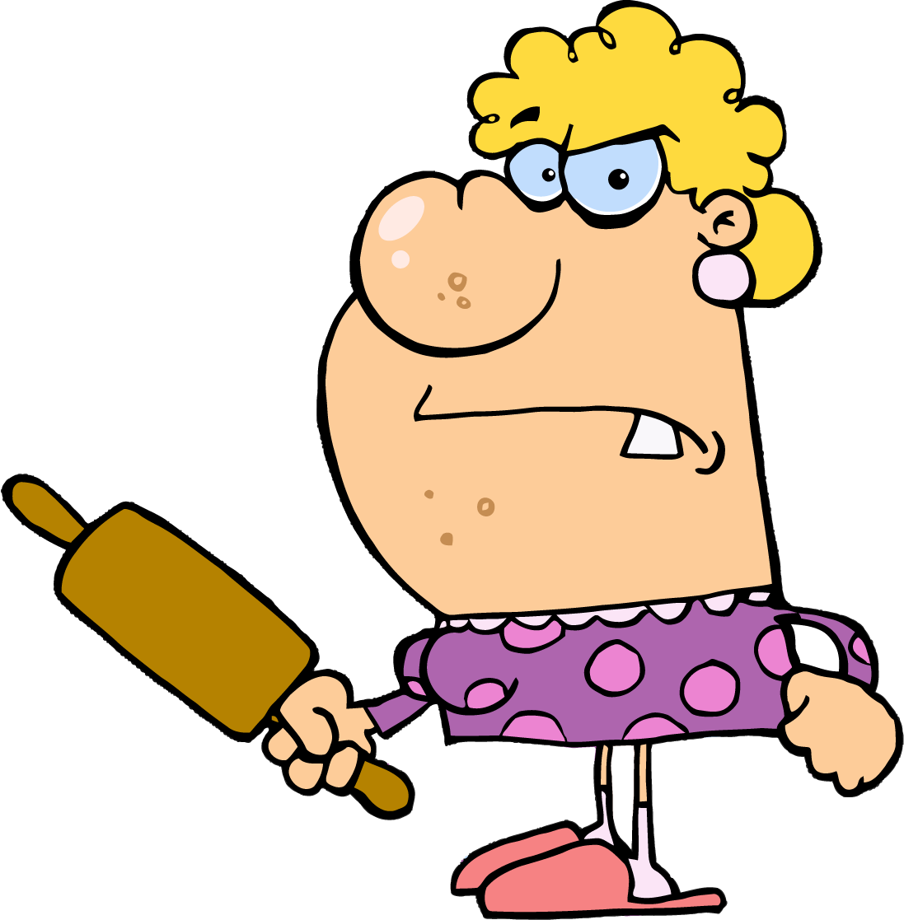
Functions of Communication #2: Contradict
I’m fine
when the nonverbal communication is the opposite of what is being said

Slide 13
Functions of Communication #3: Substitute
nonverbal communication is used in place of verbal communication

Slide 14
Functions of Communication #4: Compliment
helps to support the verbal message;
*used to emphasize or show how to do something

Slide 15
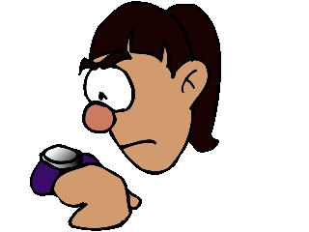
Functions of Communication #5: Regulate
nonverbal cues that keep the conversation flowing
(ex): nodding head, making eye contact, leaning forward

Slide 16
Functions of Communication #6: Accent
I’ll give you ONE last chance
use of gestures and facial expressions to emphasize or punctuate spoken words

Slide 17
Types of non-verbal Communication

Slide 18
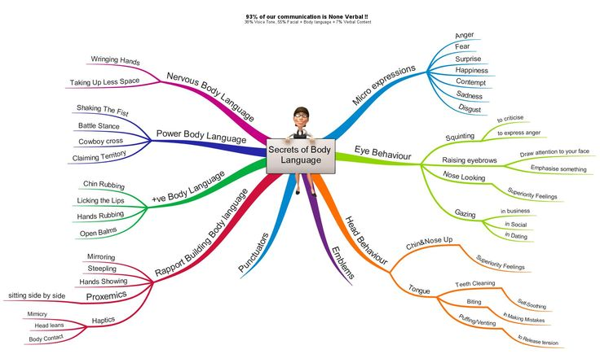

Slide 19
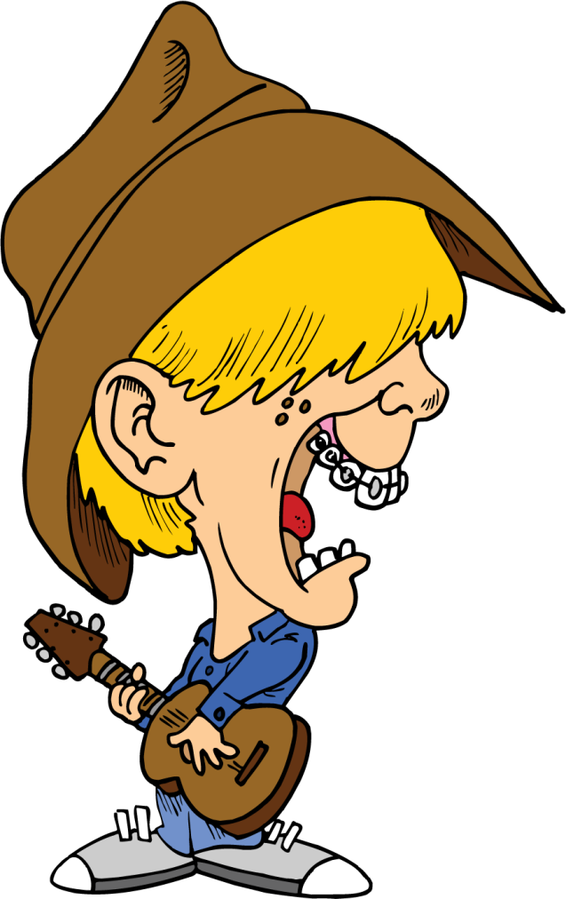
Non-Verbal Cues #1: Proxemics
how close people are to each other while communicating

Slide 20
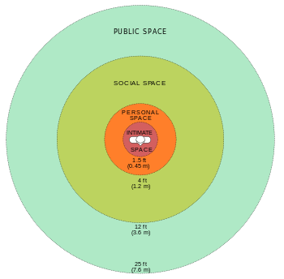
Non-Verbal Cues #1: Proxemics
https://youtu.be/frQdjs9UaYA?t=33s

Slide 21
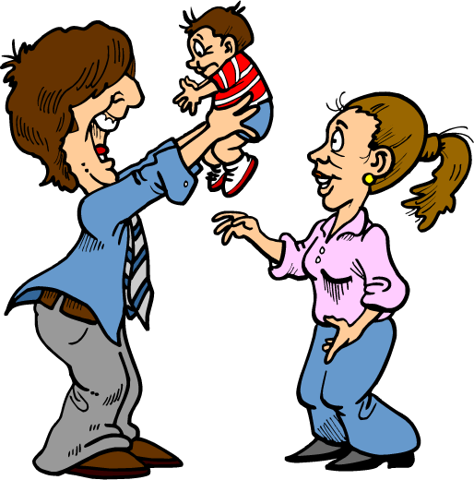
Non-Verbal Cues #2: Haptics
non-verbal communication involving touch

Slide 22
Non-Verbal Cues #2: Haptics
https://www.youtube.com/watch?v=m8h5Z-v9dzY&list=PL3609A549C2F0907C&index=17

Slide 23
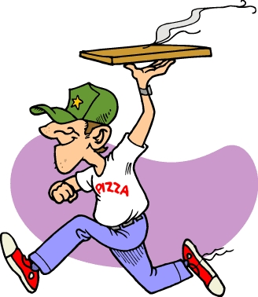
Non-Verbal Cues #3: Kinesics
non-verbal behavior related to body movement
(ex): posture, facial expressions, gestures

Slide 24
Non-Verbal Cues #3: Kinesics
http://www.youtube.com/watch?v=X1Bf_BqlDFE

Slide 25
Non-Verbal Cues #4: Oculesics
communication that is given by eyes

Slide 26
Non-Verbal Cues #4: Oculesics
http://www.youtube.com/watch?v=lB5KBM17pIs

Slide 27
Non-Verbal Cues #5: Chronemics
how we perceive time and how it can define the importance of someone or something

Slide 28
Non-Verbal Cues #5: Chronemics Examples
Punctuality: people judge others based on their ability to arrive on time
Patience: the amount of time someone is willing to wait for something sends messages to others
Interests: how time is spent and whom it is spent with demonstrates details about a person
Status: the availability of time reflects someone’s importance

Slide 29
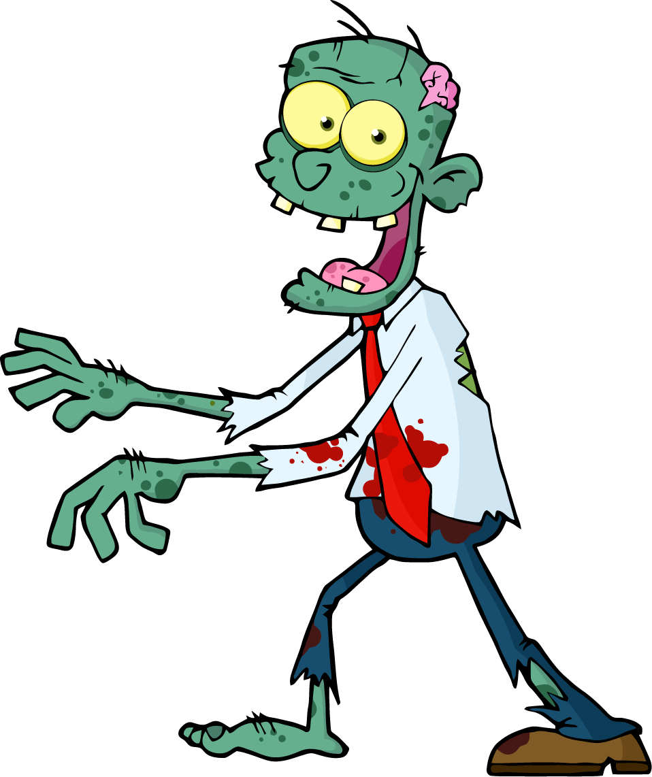
Non-Verbal Cues #6: Olfactics
the impact smells have on communication

Slide 30
Non-Verbal Cues #6: Olfactics
https://www.youtube.com/watch?v=q3dv9hH0PyA

Slide 31
Non-Verbal Cues #7: Vocalics
not WHAT you say, but HOW you say it

Slide 32
Non-Verbal Cues #7: Types of Vocalics
*Pitch
*Volume
*Tone
*Rate

Slide 33
Pitch
describes how high or low a sound is

Slide 34
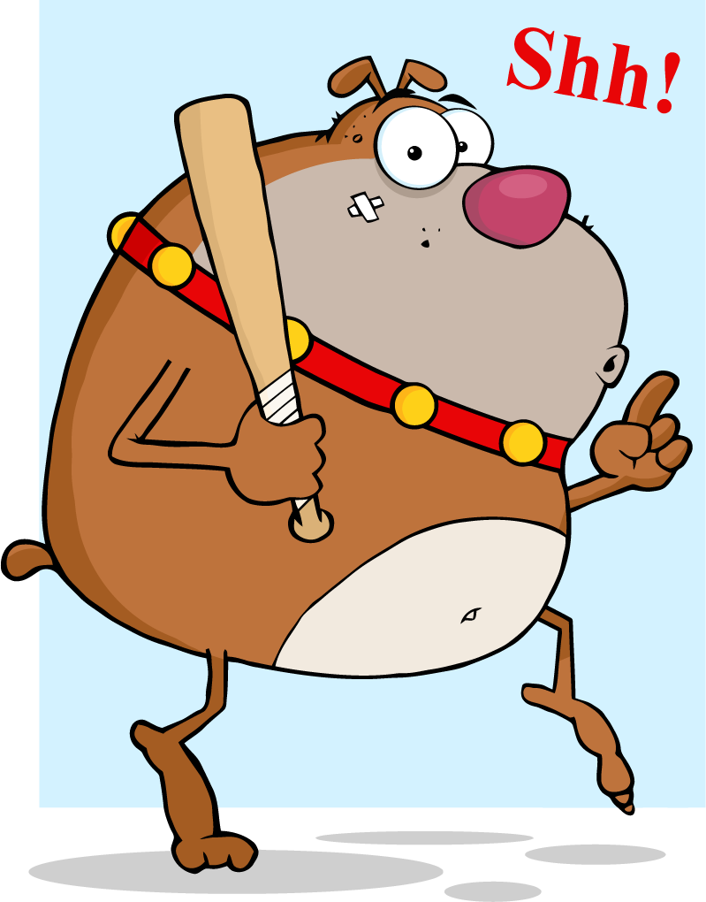
Volume
determines a sound’s loudness

Slide 35
Tone
the quality that indicates what a person is feeling or thinking

Slide 36
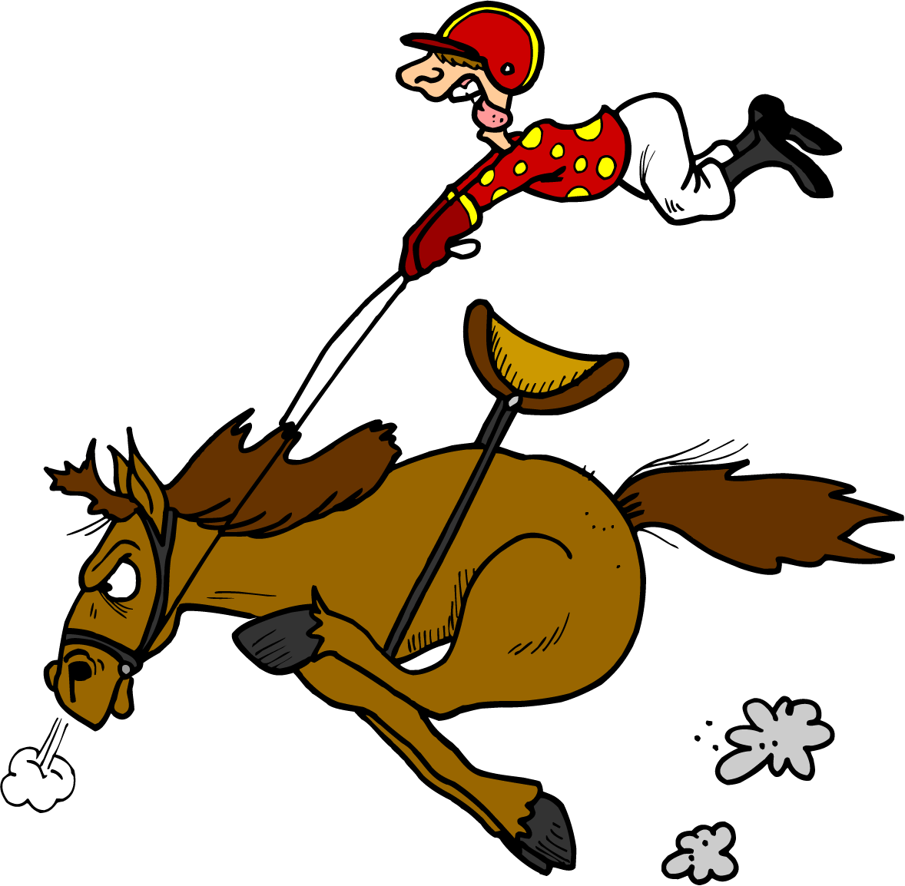
Rate
how quickly someone speaks

Slide 37
Review Game
Go to:
http://www.superteachertools.com/jeopardy/usergames/Sep201339/game1379976108.php

